Slide 1
Vitamin D
Functions of vitamin D:
Vitamin D is required by poultry for
1. Proper metabolism of calcium and phosphorus.
2.Formation of the normal bony skeletal.
3. Hard beaks and claws .
4. Strong egg shells.

Slide 2
.
Al so Vitamin D is necessary in the regulation of calcium metabolism by stimulating the intestinal absorption of calcium,
influencing osteoblast and osteoclast activity, and increasing renal tubular reabsorption of calcium in response to metabolic demands for calcium.

Slide 3
Vitamin D Deficiency
Types:
1-Rickets : In young .
2-Osteomalacia : In adult.

Slide 4
Symptoms:
1-Symptoms start about 2-3 months, after the birds were
deprived of vitamin D ( in adult).
2-Marked increase in the numbers of thin- shelled and soft-
shelled eggs followed by decrease in egg production.
Hatchability is also decrease ( In adult ).
3- Leg weakness * Penguin type squat *
The beak , claws and keel bone become very soft and pliable
( In young and adult ).
4-Inward curve of the ribs ( In young and adult ).
5- Feathering is usually poor, and an abnormal banding of feathers may be seen in colored breeds.

Slide 5
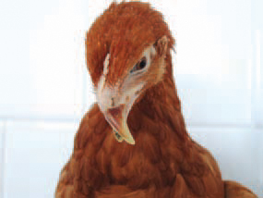
The beak : Very soft and pliable.

Slide 6
Post –mortem lesions :
A- In Adult:
1-Bones are soft and break easily.
2-Well defined knobs are seen on the inner
surface of the ribs.
3-Swollen hocks.

Slide 7
B-In Chicks(Young ):
Beading of the ribs at their juncture with the
spinal column and bending of the ribs
downward and posteriorly .
Treatment:
Feeding of a single massive dose of
vitamin D3.

